Slide 1
Nutrition: Lesson 2

Slide 2
Making Smart Choices
Focus on fruits, try things other than the usuals
Eat more dark green, leafy and orange vegetables
Make half of your grain intake “Whole Grains”
Eat calcium-rich foods – low-fat milk, yogurt and cheese
Meat – Leaner the better
- Eat more chicken and fish

Slide 3
Balancing Food & Activity
Aim for a healthy weight
60 minutes of activity each day
Increase intensity during workouts

Slide 4
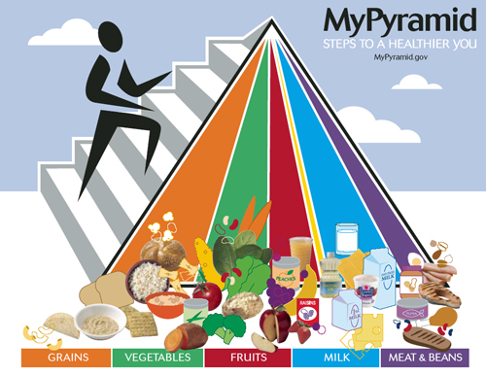
MyPyramid
Use MyPyramid to help you make healthy choices and to help you eat the right amount of food from each food group
Learn proper portion sizes to help make maintaining weight easier

Slide 5
Getting the Most Nutrition from Your Calories
Active teens can eat more without gaining weight than inactive teens
- consider your activity level and how many calories you need to get through the day
Take in Fats, Sugar, and Salt in moderation

Slide 6
Importance of Breakfast
Body uses energy all night
Studies show a healthy breakfast improves:
Mental and Physical performance all day
Reduces fatigue
Grades and attendance in school
Skipping breakfast can lead to over eating later in the day

